Slide 1
PSC CUNY Award Programs
Alexis Davis - Program Administrator
Daphne Karawita - Senior Program Assistant
John Hemminger – Assistant Project Administrator

Slide 2
About PSC CUNY Research Awards
Created and funded by the Collective Bargaining Agreement between the City University of New York and the Professional Staff Congress/CUNY.
Awards are distributed by the University Committee on Research Awards, a faculty committee, and administered by the Research Foundation of CUNY.

Slide 3
Eligibility
Full-time, permanent, CUNY Employee
Visiting professors and adjuncts are ineligible
HEO’s and CLT’s are eligible, but cannot receive Summer Salary or Release Time.
Faculty are not eligible to apply for or receive a Track 1 and 2 Award for any year in which they have or will receive external grant funding of $100,000 or more in direct costs.
Faculty members on sabbatical or scholar incentive leave may apply for and receive awards.
Instructional staff members on other leaves may apply, but must have returned to work and be back on full-time University payroll to access a PSC-CUNY award.
Faculty may not receive more than two PSC-CUNY awards during a consecutive three-year period, only one of which may be a Track 2 Award.

Slide 4
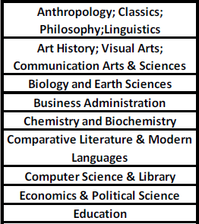
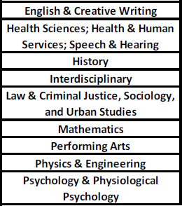
Eligibility of Proposal
18 panels that cover over 40 disciplines
The following activities will not be funded:
1) those that support fulfillment of degree requirements
2) the writing of textbooks
3) the development of a curriculum for specific courses or programs

Slide 5
PSC CUNY Cycle 57 Grants
Track 1 and Track 2
Grants Proposal System opened Sept. 22nd and will close Dec. 15, 2025
Duration of 1 year with eligibility for 6-month extension
Cycle 57 Grants begin July 1, 2026 - June 30, 2027.
Expenses or travel that falls outside of these dates are ineligible for reimbursement
Individuals may apply to only one of the two types of awards in any given year, as a Principal-Investigator (PI) or Co-PI.
*Note: Co-PI’s are ineligible for summer salary or release time.
All grant applications are filled out and submitted through the Grants Proposal System online
The GPS login credentials are self created

Slide 6
Track 1
Up to $7,000
85% of annual funding
Project Description
3 Pages (including tables and references)
single or double-spaced
one-inch margins
10-12 point font
Adobe Acrobat PDF (Microsoft Word Docs are not allowed)

Slide 7
Track 2
$7,001 and up to $15,000
15% of annual funding
Project Description
5 Pages (including tables and references)
single or double-spaced
one-inch margins
10-12 point font
Adobe Acrobat PDF (Microsoft Word Docs are not allowed)

Slide 8
Evaluation Criteria
Disciplinary panels will use the following criteria to consider the scholarly or creative merit of proposals:
Does the proposal clearly state its aims?
Does the proposal clearly state its outcomes?
Do the proposal’s aims and outcomes demonstrate scholarly or creative merit?
Do the proposed activities follow a well-conceived and feasible design?
Do the proposed activities show potential to attract other grant awards?
Is the proposed budget accurate, appropriate, and justified?
Does the proposal conform to all of the stated guidelines?
(as relevant) Did the immediate prior Research Award achieve its stated aims and outcomes?

Slide 9
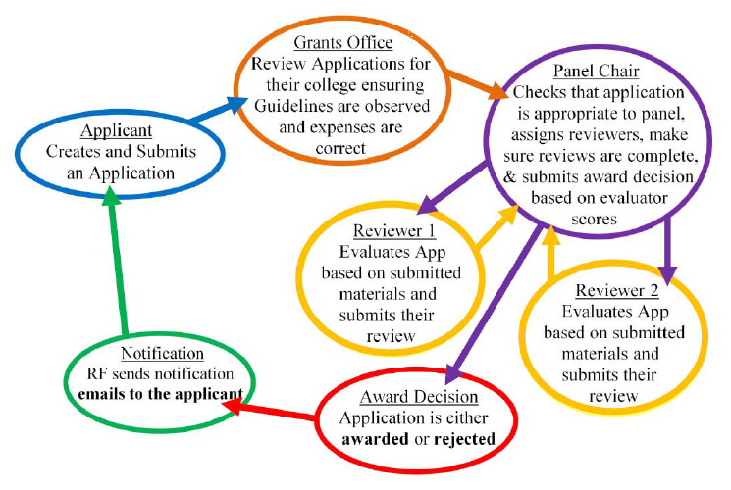
Review Panel Designations
Start
PIs must choose one discipline-based Review Panel to submit their application
Applications are subject to review only by the discipline-based Review Panel.
Applications will receive two expert reviews.

Slide 10
IRB and IACUC Approval
Human and Animal Subject use must be indicated on the application form
Related IRB or IACUC expenses must be made during the current grant period and the active IRB/IACUC approval period.
Please contact your grants office for contact information regarding the IRB personnel at your campus

Slide 11
Budget Categories
Research Staff
Clerical Staff
Summer Salary
Release Time
Office supplies
Research Supplies
Travel – Domestic & Foreign
Independent Contractors
Subject Payments
Laboratory Fees
Equipment
Publication Costs
Examples of ineligible expenses
eReaders/Kindles
Furniture (equipment)
Stipends and tuition
P-cards
Journal Subscriptions
Internet and Cellular Service
Advertisements
Insurance
Memberships in professional organizations
Any item/service that serves an ongoing need
Subcontracts
Renovations
Indirect compensation to the Principal Investigator

Slide 12
Summer Salary
A maximum of $7,000 or $15,000 may be awarded dependent on grant.
Subject to 25.05% rate fringe benefits
The investigator is not eligible for summer salary during any month in which he/she is teaching classes and applying 100% effort.
PIs may only receive summer salary once within a rolling three-year period, regardless of Award type.
Principal Investigators who are paid on a 12-month basis are not eligible to receive summer salary.
HEO’s, CLT’s ineligible for summer salary
Co-PI’s are ineligible for Summer Salary

Slide 13
Release Time
PIs may apply for Reassigned Time at the “Instructor, Lecturer, Adjunct Lecturer, Adjunct Lecturer (Doctoral Student)” single rate as of December 15 of the submission year in Article 24.6 of the contract. These rates will be:
For Academic Year 2025-2026: $6,024.60 (3-credit); $7,530.75 (4-credit)
For Academic Year 2026-2027: $6,986.40 (3-credit); $8,733 (4-credit)
For Academic Year 2027-2028: $7,100 (3-credit); $9,466.67 (4-credit)
Must be approved by Department Chair for eligible use
Instructional staff in non-faculty titles are not eligible for released time.
Co-PI’s are ineligible for Release Time

Slide 14
Travel – Domestic & Foreign
Proposed travel requires a detailed justification including:
an itinerary with proposed dates
the duration at each location
transportation costs
estimated per diem expenses
other anticipated travel-related expenses
Foreign travel must demonstrate that collections and/or resources are not available in the United States.
Travel for assistants must be specified and justified.
Purchase of travel items awarded in the budget on or after 5/1/2026 is allowable, however actual travel must occur within the budget period (7/1/2026- 6/30/2027).

Slide 15
Final Project Reports
PIs who wish to apply for a new Research Award within three years must include a copy of the Final Project Report from their immediate prior completed Award for review consideration as part of their new application.
Awards in a six-month extension period are considered completed for this requirement.
For instance, Cycle 57 applicants must submit their Final Project Report if they are a Cycle 55 Awardee.
Submissions that do not adhere to this requirement will not be considered.

Slide 16
Post-Tenure Reassigned Time Award Pilot
The Post-Tenure Reassigned Time Award is a pilot program (“the Pilot”) that provides course release(s) for tenured Assistant and Associate Professors to engage in meritorious research, scholarly, and creative activities.
The Pilot will span Academic Years 2025-2026, 2026-2027, and 2027-2028, at which time the Pilot may be continued, modified, or terminated.

Slide 17
Eligibility
All tenured Assistant and Associate Professors are eligible to apply.
Each eligible PI may receive only one (1) Award during the Pilot duration (2025-2028).
All PIs must obtain prior approval from the college or school for Reassigned Time to be eligible for an Award.
Documented approval for Reassigned Time from the PI’s Department Chair and College President or their designee is required
PIs who possess, or subsequently receive, external grant direct costs of $100,000 or more in the year of their submission are not eligible.
Co-Principal Investigators are not allowed.

Slide 18
Structure
CUNY Community College: one (1) 3-credit course release or two (2) 3-credit course releases at the Adjunct Replacement rate
CUNY Senior College, Comprehensive College, or Professional School: one (1) 3-credit course release at the Adjunct Replacement rate
For Academic Year 2025-2026: $6,024.60 for a 3-credit course release and $12,049.20 for a 6-credit course release
For Academic Year 2026-2027: $6,986.40 for a 3-credit course release and $13,972.80 for a 6-credit course release
For Academic Year 2027-2028: $7,100 for a 3-credit course release and $14,200 for a 6-credit course release

Slide 19
Cycle 1 Grants
RT System opened Sept. 22nd and will close Dec. 15, 2025
Duration of 2 years; extensions are not allowable
Cycle 1 Grants begin July 1, 2026 - June 30, 2028.
Each PI must also transmit a copy of their Pilot proposal, as submitted, to their Department Chair and College President (or designee) on or before December 15.
All grant applications are filled out and submitted through the Reassigned Time System online
The RTS login credentials are self created. Credentials are shared with GPS.

Slide 20
Submissions
Project Description
3 Pages (including tables and references)
single or double-spaced
one-inch margins
10-12 point font
Adobe Acrobat PDF (Microsoft Word Docs are not allowed)
Documented approval for Reassigned Time from the PI’s Department Chair and College President or their designee

Slide 21
Evaluation Criteria
Disciplinary panels will use the following criteria to consider the scholarly or creative merit of proposals:
Does the proposal clearly state its aims?
Does the proposal clearly state its outcomes?
Do the proposal’s aims and outcomes demonstrate scholarly or creative merit?
Do the proposed activities follow a well-conceived and feasible design?
Do the proposed activities show potential to attract other grant awards?
Is the proposed budget accurate, appropriate, and justified?
Does the proposal conform to all of the stated guidelines?

Slide 22
Review Process
Each application will be assigned to and reviewed by the appropriate discipline-based panel from the PSC-CUNY Research Awards.
Panels will select the applications that are meritorious according to the Criteria.
Panel Chairs will send all meritorious applications to the CUNY Research Foundation for prioritization based on A.) number of years since tenure; B.) college; C.) application date.
CUNY’s Associate Vice Chancellor for Research and PSC-CUNY’s President will then receive this prioritized list of meritorious applications and select the award recipients to ensure an equitable award distribution. Awards will be granted until funds for the cycle are exhausted.

Slide 23
Q&A
Alexis Davis, Program Administrator - PSC CUNY
Email: alexis_davis@rfcuny.org
Phone: 212.417.8464
Daphne Karawita, Senior Program Assistant
Email: daphne_karawita@rfcuny.org
Phone: 212.417.8475
John Hemminger, Assistant Project Administrator
Email: john_hemminger@rfcuny.org
Phone: 212.417.8474
PSC CUNY Group Mail
Email: PSC_CUNY@rfcuny.org
Research Foundation Website
rfcuny.org
Grants Proposal System
rfcuny.org/gp/welcome.aspx
Reassigned Time System
rfcuny.org/rt/welcome.aspx

