Slide 1


Service Center Calculations Tackling the Challenges
CUNY
Huron Consulting Group
© 2018 HURON CONSULTING GROUP INC. AND AFFILIATES. ALL RIGHTS RESERVED.

Slide 2
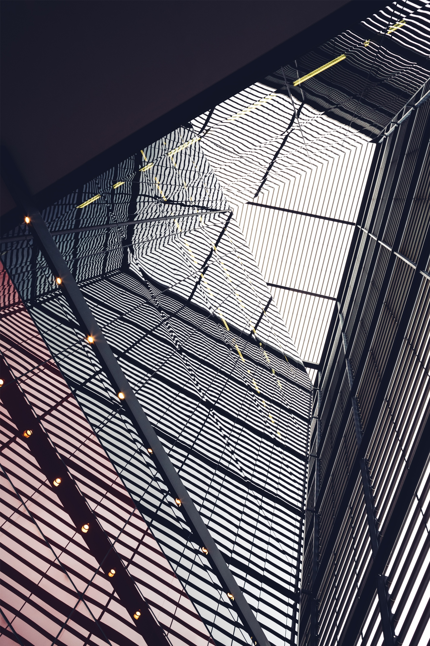

Agenda
1 | Introduction | 4 | Other Considerations
2 | Service Center Overview | 5 | Questions
3 | Creating A New Service Center

Slide 3

Introductions
PRESENTERS:
  Wendy Meister, Senior Director, Huron Consulting Group
  Patrick Muzin, Manager, Huron Consulting Group
Audience:
  Name
  Core/Area/Facility

Slide 4

Service center Overview

Slide 5



Overview
Types of Service Centers
Institutional Service Centers
  Serves a large portion of the institution
  Examples: IT Support, Facilities
Recharge Centers/Core Facilities
  Serves localized operation providing more specific service
  Examples: Mass Spectrometry, High Performance Research Computing
Specialized Service Facilities (SSF)
  Serves specific function with significant support costs and revenue in excess of $2 million per year
  Example: Animal Research Facility, Center for Nanoscale Systems

Slide 6
Overview
Recharge Centers/Core Facilities
Core facilities are centralized shared research resources that provide access to instruments, technologies, services, as well as expert consultation and other services to scientific and clinical investigators.*
  The typical core facility is a discrete unit within an institution and may have dedicated personnel, equipment, and space for operations.
  In general, core facilities recover part or all of the cost of providing service in the form of user fees that are charged directly to an investigator's funds, which are often funded by the NIH or other federal agencies.
*Source: NIH Core Facilities FAQ

Slide 7
Federal Regulations
The Uniform Guidance
The Uniform Guidance does not explicitly address service centers (SC).
§ 200.468 Specialized Service Facilities
(a) The costs of services provided by highly complex or specialized facilities such as computing facilities, wind tunnels, and reactors are allowable, provided the charges for the services meet the conditions of either paragraphs (b) or (c) of this section, and, in addition, take into account any items of income or Federal financing that qualify as applicable credits under §200.406 Applicable Credits.
(b) The costs of such services, when material, must be charged directly to applicable awards based on actual usage of the services on the basis of a schedule of rates or established methodology that:
(1) Does not discriminate between activities under Federal awards and other activities of the non-Federal entity for Internal purposes, and
(2) Is designed to recover only the aggregate costs of the services. The costs of each service must consist normally of both its direct cost and its allocable share of all indirect (F&A) costs. Rates must be adjusted at least biennially, and must take into consideration over/under applied costs of the previous period(s).

Slide 8
Federal Regulations
The Uniform Guidance
The Uniform Guidance does not explicitly address service centers (SC).
§ 200.468 Specialized Service Facilities
(c) Where the costs incurred for a service are not material, they may be allocated as indirect (F&A) costs.
(d) Under some extraordinary circumstances, where it is in the best interest of the Federal government and the non-Federal entity to establish alternative costing arrangements, such arrangements may be worked out with the Federal cognizant agency for indirect costs.

Slide 9
Federal Regulations
Summary
Costs must be charged directly to federal awards based on actual usage according to rates calculated using a methodology which:
Does not discriminate against Federally supported activities
Is designed only to recover aggregate costs of services
Costs should consist of direct costs and allocable share of F&A costs (necessity to include F&A costs is specific to SSFs)
Rates should be adjusted at least biennially
Adjustments should be made to account for over/under recovery

Slide 10
Maintaining Compliance
Common Issues
Many common issues and federal red flags stem from inadequate policies, procedures, or institutional oversight.
Common Issue
Charging billing rates higher than the cost of providing the specific good or service, especially on Federal awards Rates structure discriminates between users funded by Federal sources Charging users different rates from published list of billing rates
Surplus balances used to fund unrelated activities Not reviewing and adjusting rates to ensure that service center rates are always attempting to break even.
Billing rates include equipment depreciation expense, ignoring that: Rates can only include one year of depreciation, not the full cost of equipment Depreciation included in SC rates can not also be in the F&A rate
Subsidies can not be included in the F&A rate

Slide 11
Audit Summary
Audit Findings
2014 University of South Florida
2012 Florida State
2006 University of Arizona Sahara Center
2006 University of Connecticut
2005 Dartmouth
2005 University of Massachusetts Medical School

Slide 12
Audit Findings
Compliance Violations
OIG Audit Findings revealed these as some reasons for overcharges in universities’ Service Centers.
Did not maintain adequate accounting records.
Did not provide adequate monitoring of service centers and adjust billing rates on a regular basis.
Used surplus from service centers to fund unrelated activities.
Specialized Service Centers: Overstated anticipated expenses, overcharged the government and billed for items not covered by the grants.
Did not establish or adhere to policies and procedures.
Did not use published billing rates for all customers.
Include unallowable costs in the billing rates.
Overcharges

Slide 13
Creating a New Service Center

Slide 14
Service Centers
Where to Start?
1
Identify all services which should have unique billing rates
2
Create multiyear business plan including projected costs and utilization of services
3
Calculate billing rates for each service and assess the need for other rates (i.e. external, other academic, etc.)
4
Review proposed rates and create new account or fund to track service center expenses and revenues in the institution’s financial system

Slide 15
Service Centers
Rate Structure
HOW MANY RATES?
A specific billing rate should be established for any service which has costs unique to that service, such as specialized equipment or dedicated staff.
  Separate rates must also be calculated if there is a different user population for each service.
  Rates are set for each instrument or group of instruments for a specific process.
Identifying costs for each service ensures that one service is not subsidizing a service with higher costs.
What is the appropriate unit of measurement to use for each billing rate?
  Per-unit (e.g. billed for each sample prepared)
  Time based (e.g. billed hourly)
  Flat Fee (e.g. billed per use)
  Combination (e.g. flat fee + fee per unit)

Slide 16
Service Centers
Rate Structure: Direct & Indirect Costs
IDENTIFY ALL DIRECT COSTS
Below is a list of typical operating costs included in service center rate calculations:
  Staff Salaries and Wages
  Fringe Benefits
  Materials and Supplies
  Repair Costs and Maintenance Contracts
  Carry-forward Surplus/Deficit
  Equipment Depreciation (optional)
Unallowable And
Indirect Costs
Unallowable costs and indirect costs that are included in an institution’s F&A rate calculation may not be included in the Service Center rate calculation
  Refer to §200 Sub-part E for federal cost principles
Typically, indirect costs such as building depreciation and institutional administrative salaries should not be included in budget.

Slide 17
Calculate Billing Rates
The Rate Equation
Total Allowable Annual Costs
Annual Usage Volume
Billing Rate
Per Unit

Slide 18
Calculate Billing Rates
Sample Billing Rate - Electron Microscope
Cost Category | Projected Annual Cost | % Allocated to Service | Total Service Costs
Staff Salaries | $100,000 | 25% | $25,000
Benefits (30%) | $30,000 | 25% | $7,500
Supplies | $5,000 | 100% | $5,000
Maintenance Contract | $1,000 | 100% | $1,000
Equipment Depreciation | $500 | 100% | $500
 | Total Annual Costs |  | $39,000
 | Projected Annual Use |  | 1,000 Hours
 | Calculated Break-even Rate |  | $39.00/Hour

Slide 19
Billing and Accounting
Tracking Revenue and Expenses
Many institutions use a specific department, fund, or account number in their accounting system to identify and track active service centers.
Separate fund or account numbers are recommended for tracking specific expenses and/or revenue for service centers with rates for multiple services
Service center administrators may be required to submit a request for the creation of a new fund or account number.
Revenue from internal and external customers should be tracked using separate subaccounts or object codes.
What mechanisms does CUNY ASRC have in place for creating a new fund or account for a service center?
All invoices should include the name of the service provided, the number of units, and the amount charged per unit.
Billing must be processed on a timely basis but cannot occur until the service or good has been provided.

Slide 20
Best Practices
Charging Market Rates
In instances where services are provided on a market price basis (not a calculated rate basis) the normal market price may be charged to external customers only.
  Market rate should cover at least the full cost of the services provided, including F&A costs for external customers.
  Unrelated Business Income Tax (UBIT) issues may arise if the service center is recovering in excess of its full costs
  What documentation does your institution require?

Slide 21

Best Practices
Operating Reserve Balance
2 CFR 200, Appendix V, Section G.2
Charges by an internal service activity to provide for the establishment and maintenance of a reasonable level of working capital reserve, in addition to the full recovery of costs, are allowable. A working capital reserve as part of retained earnings of up to 60 calendar days cash expenses for normal operating purposes is considered reasonable. A working capital reserve exceeding 60 calendar days may be approved by the cognizant agency for indirect costs in exceptional cases.
Service centers are permitted to maintain a 60 day operating reserve balance, however the center may be asked by the government to provide documentation to support that amount.
Equipment reserve costs can not be built into billing rates, although equipment depreciation recovered through standard billing rates can be set aside for future equipment purchases.

Slide 22
Other Considerations

Slide 23
F&A Rate Proposals
The F&A Equation
Facilities Costs
(Indirect Costs)
Administrative Costs
(Indirect Costs)
Indirect Costs
  Building Depreciation
  Equipment Depreciation
  Interest
  Operations & Maintenance
  Library
  President’s Office
  Legal
  Human Resources
  Sponsored Programs
  Pre-award
  Department Administrators
  Clerical and Support Staff
  Annual Facilities and Administrative costs are aggregated and known as “Pool” costs. They are the numerator in the F&A formula.
Total Base Costs
(Direct Costs)
  Organized Research
  Other Sponsored Activities
  Instruction
  Other Institutional Activities

Slide 24

F&A Rate Proposals
Equipment Depreciation
Equipment depreciation can be recovered either through the F&A rate or service center billing rates… NOT BOTH!
  If equipment is included in service center rate calculations, it MUST be excluded from the F&A Rate proposal.
  Proper tracking of this equipment is critical
Do you allow equipment costs in service center rates and if so, how do your track it?
The full cost of the equipment cannot be built into the service center rates, only annual depreciation.
Equipment used in service centers can have a different useful life than similar assets at the university.
  Service centers must be able defend shorter life.

Slide 25

F&A Rate Proposals
Equipment Reserves
An equipment replacement reserve is not an allowable cost for a federal billing rate.
  Non-federal billing rates can include a cost for an equipment replacement reserve.
Allowable equipment depreciation returned to the center via the billing rates can be set aside into a reserve for future equipment purchases.
Surplus balances in the service center operating account must be used as carry forward adjustments and may not be used to purchase equipment.

Slide 26



F&A Rate Proposals
Negotiation Issues
Data requests have recently asked for additional detail and documentation regarding service centers, including:
How are service center rates charged?
Are indirect costs included in service center rates?
Are all service center users (both internal and external) billed at the same rates?
How are over/under recoveries handled?

Slide 27

Questions?

Slide 28
Appendix

Slide 29
Additional Cost Accounting Federal Guidelines
  Guidelines:
    Cost Accounting Standards (CAS), Disclosure Statement, DS-2
UG 200.468 Specialized Service Facilities
NIH FAQs for Costing of NIH-Funded Core Facilities

