Slide 1
NECA
September 2015
Rate Extensions under the Uniform Guidance
Steve Bradley

Slide 2
Topics
New Federal Guidance for Extensions (UG)
Documentation Needed for Requests (CAS / ONR)
Critical Factors for Extension Analyses (EA)
Results of MAXIMUS Recent Extension Analyses
Summary / Conclusions

Slide 3
New Federal Guidance on Extensions
§200.414 Indirect (F&A) costs, Section (g)
  This extension will be subject to the review and approval of the cognizant agency for indirect costs.
  If an extension is granted the non-Federal entity may not request a rate review until the extension period ends.
CAS or ONR

Slide 4
Changes Due to Uniform Guidance
§200.414 Indirect (F&A) costs, Section (g)
  Any non-Federal entity that has a current federally negotiated indirect cost rate
  may apply for a one-time extension of the rates in that agreement
  for a period of up to four years.
1 or 2
1 or 2 or 3
1 or 2 or 3 or 4
1

Slide 5
Changes Due to Uniform Guidance
§200.414 Indirect (F&A) costs, Section (g)
  At the end of the 4-year extension, the non-Federal entity must re-apply to negotiate a rate.
  Subsequent one-time extensions (up to four years) are permitted if a renegotiation is completed between each extension request.
%     %    % 

Slide 6
Documentation Requirements (as far as we know!)
Financial Data
Last Financial Statement
Last A-133 or single audit
Base Data
Last base year to most recent
Forecast next 4 years
Space Data
Changes from last base now
Forecast next 4 years

Slide 7
Critical
Factors
For
Extension
Analyses

Slide 8

Expectations of Senior Leadership
If Leadership Guidance is to Decrease or only Maintain current F&A rates
    GAME OVER!
If Leadership Guidance is to Increase F&A Rates (& Revenues)
    LET’S ROCK!

Slide 9
New Staff / Other Transitions
University has no, or, very new, F&A staff
  Could consider external assistance to prepare F&A Proposal
University very recently changed to, or will implement, a new Financial / Space / other IT systems during the F&A “base” year
The cloud

Slide 10
Organized Research MTDC Base
Very large increase in the MTDC base
  May want to model in CRIS to derive pro forma rates
  Significant decrease in research grant $ volumes
    Termination of ARRA grants, current federal grant funding levels, loss of PI / Researchers, etc.
    May yield higher proposed /negotiated F&A rates
  Universities may need higher F&A rates just to maintain the current F&A $ Recovery stream
$$$$$$$$$$$$$$$$$$$$$

Slide 11

Utility Cost Adjustment (UCA)
UG, Apdx III, section B4…….. “A utility cost adjustment of up to 1.3 percentage points may be included in the negotiated indirect cost rate of the IHE for organized research, per the computation alternatives…”
Extended beyond original 65 universities to all institutions
Not a total “deal maker” by itself
But, could influence universities “sitting on the fence” about submitting F&A Proposals

Slide 12
Construction of New Research Buildings
One of the most Vital Factors
Occupied recently or to be completed during the “life” of the next F&A Agreement
Universities need to be reimbursed for increased costs of doing research (building depreciation and bond interest)
Perform “what if” analyses (acquisition costs, % OR usage)
Challenges: Cognizant federal agencies have stringent documentation standards (e.g., “Best Practices Manual” / template; O&M, Equipment)

Slide 13


Expectations for F&A Revenue Stream
This may be vital if F&A $ Recoveries are a major contributor to overall University Revenues (e.g., > 5%+)
Allocation of F&A $’s to “Central” or to Departments/other units
Trends in State funding?
“Sensitivity Analysis” & Return on Investment (ROI)
  Incremental value of each 1 point per year
  Cost of F&A Proposal process vs. incremental value of new rate (e.g., total University & external costs of $300K but may generate additional $8M over next 4 year F&A Agreement)
$300K
$8M

Slide 14
Prior F&A Rate Trends
Difference between proposed and negotiated rates during last cycle
  High variance: submit to recover “points left on the table” last time (e.g., Proposed 60% but accepted 50%)
  Low variance: may suggest an Extension is more viable, assuming no other major changes (e.g., Proposed 56% and negotiated 54%)
Overall “Direction” of rates during prior cycles
  University has been receiving extensions over the past cycles with small decreases (e.g., normal .50 to 1.0 points)
    Indication that institution may need to consider more aggressive approach to F&A Proposals
  Large increases in recent cycles may make Extension more viable

Slide 15

New O&M Facilities
  Uncapped pools
  Mainly utility-related additions or renovations
    Multi-million dollar addition to the heat plant
    New chiller for research precinct
  Only if used by research facilities
  Could include EHS improvement - incinerator

Slide 16
Three
Case
Studies

Slide 17
University Case Study # 1
Metrics / Outstanding Features
  RES MTDC base = $40M in last F&A Proposal
  Primarily Med Sch and Eng Sch grants (e.g., at full F&A rate)
  RES grant volume = Decrease of 10% over past 4 years
  Not previously eligible for UCA
  Last Proposal had difference of 6 points between proposed/negotiated
  “Sensitivity Analysis” = 1 point increase yields $300K / year
  But, no new RES Bldgs projections
  Strong possibility of negotiating 2 points Increase with CAS
MAXIMUS EA Report
  University should strongly consider F&A Proposal submission to avoid loss of estimated $1.2M F&A $ Recoveries over 4 years

Slide 18
University Case Study # 2
Metrics / Outstanding Features
  RES MTDC base = $43M in last F&A Proposal
  Not previously eligible for UCA
  Last Proposal had difference of 1.3 points between proposed/negotiated
  “Sensitivity Analysis” = 1 point increase yields $300K / year
  New leadership in Office of Research Administration and Controller
  New space system
MAXIMUS EA Report
  University should strongly consider requesting one-year rate extension
  FY17 very likely higher proposed rate than FY16 base
  Plus allow upheaval of changes to settle down

Slide 19
University Case Study # 3
Metrics / Outstanding Features
  RES MTDC base = $155M in last F&A Proposal
  Not previously eligible for UCA
  ONR cognizant
  “Sensitivity Analysis” = 1 point increase yields $1M/ year
  Leadership wants no rate increase but F&A should reflect actual cost
  New $98M 40% OR research building (impact = 0.4 to1 point increase)
  Base decrease projected to be 6% (impact = 1 to 2 point increase)
  Remove non-fed sponsor funded depreciation $1M (0.4 to 0.6 point decrease)
MAXIMUS EA Report
  FY14 best base for rate increase, rate extension best if want to maintain rate. Depends on leadership goals.

Slide 20
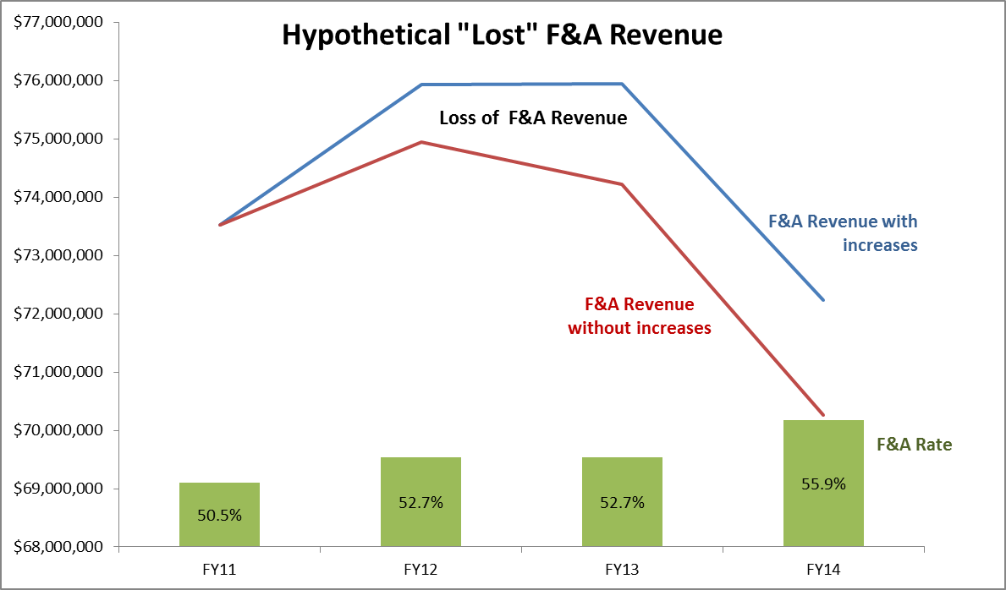
University Case Study # 3

Slide 21
Summary / Conclusions
The new UG offers more liberal F&A Rate Extensions
  This may be viable for some Universities
However, institutions should consider myriad factors, such as:
  Potential reduction of F&A Revenue
  Need to recover costs of new RES Bldgs
  Various “tools” can assist Universities with these assessments
    ROI studies
    “Sensitivity analyses”
    CRIS “Projection” modeling

Slide 22
Questions?

