Slide 1
Effort Reporting and OMB Uniform Guidance
Presented by:
      Jennifer W. Mitchell
      Director of Cost Studies and Effort Reporting Northwestern University
      Sarah T. Axelrod
      Director of Cost Analysis and Compliance Harvard University

Slide 2
Agenda
Introduction
Where to Begin
Comparison & guidance
Next…
Organization of Subpart 200.430
Comparison between the new guidance and A-21, Section J.10
Internal controls and other key topics
Recommendations
University actions taken
Audit experiences

Slide 3
Where to Begin?

Slide 4
What’s in a Word?
“Must”
  Interpreted as Required
“Should”
  Interpreted as Best Practice or Recommended Approach
“Must”
  Appears numerous times in the new guidance
“Should”
  Appears many times but less than “Must”

Slide 5
Federal Regulations -
Comparison & Guidance

Slide 6
§ 200.430 Compensation – Personal Services vs. A-21, Section J.10
Overall Comparison
Internal Controls emphasized
Written Policies and Procedures, or Definitions emphasized
Requirements under (i) Standards for Documentation
“IBS” introduced
3 acceptable methods and reporting frequency removed (“after-the-fact” mentioned under Budget Estimate )
Certification attesting work performed removed
Assessment
More flexibility BUT traded off with…
Internal control(s) mentioned 34 times
§ 400.430 alone:
  “written” policies or definitions mentioned 13 times.
  “prior” approval mentioned twice

Slide 7
Topics Associated with “Written” Policies or Definitions
Topic | Ref. | Notes
Compensation - General | (a)(1) | conforms to the established written policy
Appointment | (a)(2) | non-Federal entity's laws and/or rules or written policies
Professional activities outside non-Federal entity | (c) | "must" follow its written non-Federal entity-wide policies
Incidental activities | (h)(ii) | allowable under written institutional policy; must be specifically provided for in the Federal award budget or receive prior written approval
Extra Service Pay | (h)(i) | consistent written policies applicable to all faculty members
IBS under Extra Service Pay | (h)(4)(ii) | consistent written definition of work covered by IBS
Salary supplemented under Extra Service Pay | (h)(4)(iv) | fall within the salary structure and pay ranges established by and documented in writing or otherwise applicable to the non-Federal entity.
Periods outside the academic year - Teaching | (h)(5)(ii) | based on the normal written policy
Sabbatical leave costs | (h)(7)(i) | allowable provided the IHE has a uniform written policy
Salary rates for extra Service Pay - non-faculty members | (h)(8) | in accordance with the non-Federal entity's written policy

Slide 8
Internal Controls
§ 200.303 Internal Controls
  Must maintain effective internal control over the federal award that provides reasonable assurance…
  Should be in compliance with COSO and Standards for Internal Control in the Federal Government (the “Green Book”).
  Must comply, evaluate and monitor compliance with federal statutes, regulations and the terms and conditions of the federal awards
  Must take prompt action when non-compliance is identified
  Must take reasonable measures to safeguard personally identifiable information and other information designated as sensitive
Assessment
Is your school’s current Effort Reporting System sufficient for Internal Controls?
Unknown as of this time what will withstand an OIG audit of Internal Controls?
Written institutional policies enforce internal controls

Slide 9
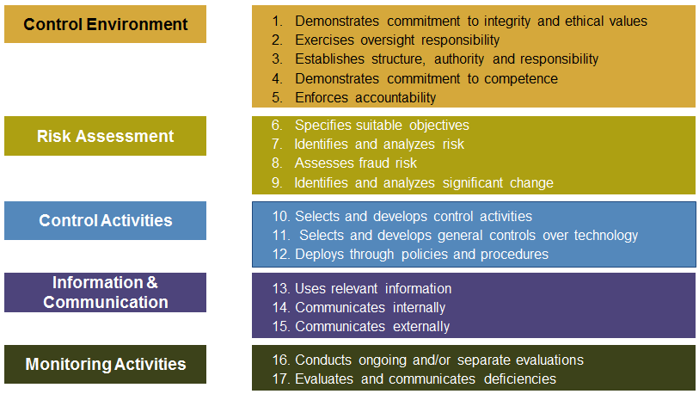
COSO’S Internal Control–Integrated Framework (2013 Update)
- Codification of 17 principles supporting the five components
(* May 2013 COSO outreach presentation)

Slide 10
§ 200.430, (a) through (f)
Compensation – (a) to (f)
(a) General
(b) Reasonableness
(c) Personal activities outside the IHE
(d) Unallowable Costs
(e) Special consideration in determining allowability of compensation
(f) Incentive compensation
IHEs:
(h) Requirements specific for IHEs
Some Key Points
Follows the appointments of IHEs
Determined and supported by (i) Standards for documentation
Outside activities – “must” follow IHE’s policy
Costs that are unallowable under other sections “must” not be allowed in this section
Subject to ceiling in accordance with statute(e.g. NIH salary cap)

Slide 11
§ 200.430, (h) – Requirements for IHEs
(h) Institutions of higher education (IHEs)
Certain Conditions – better clarification: allowable and incidental activities
Salary basis
Intra-institution of IHEs
Extra service pay/Overload
Periods outside the academic year
Part-time faculty
Sabbatical leave
Salary rates for non-faculty members
Assessment
Overall, clearer definitions and better examples:
    New examples of allowable activities such as developing and maintaining protocols (human, animals, etc.), managing substances /chemicals, managing and securing project-specific data, coordinating research subjects
  IBS introduced & emphasized

Slide 12
Institutional Base Salary (IBS)
Annual compensation paid by the University for an employee’s appointment (9 or 12 months), whether that individual’s time is spent on research, teaching, or other activities
  Compensation should be documented in writing, generally letters come from Faculty Affairs or comparable offices
IBS must be used as the base salary on all grant proposals

Slide 13
Institutional Base Salary (IBS)
IBS includes:
  Guaranteed salary
    Base salary
    Chairmanship, director’s pay? According to IHE’s written policy
IBS does not include:
  Bonuses
  One-time payments
  Incentive pay (not guaranteed)
  Payments from other organizations
  Income that individuals are permitted to earn outside of their University responsibilities, such as consulting
Notes:
What does IBS have to account for?
Teaching (including prep time)
Advising students
Committee work
Writing recommendations
Writing grant proposals
Administrative duties
Department or other chairmanships

Slide 14
§ 200.430, (i) Standards for documentation
(i)(1)(i) to (i)(1)(viii)
Charges to Federal awards for salaries and wages must be based on records that accurately reflect the work performed
Be supported by a system of internal control which provides reasonable assurance that the charges are accurate, allowable, and properly allocated
Reasonably reflect the total activity for which the employee is compensated by the non-Federal entity, not exceeding 100% of compensated activities
Assessment
“accurately reflect the work performed” emphasized
Internal Controls emphasized: accurate, allowable, and properly allocated
Reasonably reflect the total activity… - similar to A-21, Section J.10

Slide 15
§ 200.430, (i) Standards for documentation
– Budget Estimates
(i)(1)(viii) Budget Estimates
Budget estimates (i.e., estimates determined before the services are performed) alone do not qualify as support for charges to Federal awards
Significant changes in the corresponding work activity (as defined by the non-Federal entity’s written policies) are identified and entered into the records in a timely manner. Short term (such as one or two months) fluctuation between workload categories need not be …
  Internal controls includes processes to review after-the-fact interim charges
All necessary adjustment must be made such that the final amount charged to the Federal award is accurate, allowable, and properly allocated
Assessment
“after-the-fact” mentioned (also in A-21)
Short-term fluctuation defined as no more than 2 months. However, final amount must be accurate…

Slide 16
§ 200.430, (i) Standards for documentation
(i)(1)(ix) to (i)(1)(x)
May reflect categories of activities expressed as a percentage distribution of total activities
“teaching, research, service, and administration are often inextricably intermingled in an academic setting. …a precise assessment of factors that contribute to costs is therefore not always feasible, nor is it expected”
Assessment
Similar to the language in A-21, Section J.10

Slide 17
§ 200.430, (i).3 – Documentation for Nonexempt Employees
(i)(3)
In accordance with Department of Labor regulations implementing the Fair Labor Standards Act (FLSA) (29 CFR Part 516), charges for the salaries and wages of nonexempt employees, in addition to the supporting documentation described in this section, must also be supported by records indicating the total number of hours worked each day.
Assessment
For non-exempt employees, time cards/timesheets will suffice but also subject to internal controls. e.g. , reasonable, accurate, allowable, and properly allocated

Slide 18
§ 200.430, (i).8 – Records not meeting the standards
(i)(8)
For a non-Federal entity where the records do not meet the standards described in this section, the Federal government may require personnel activity reports, including prescribed certifications, or equivalent documentation that support the records as required in this section
Assessment
Federal government can impose personnel activity reports (same as in A-21) when it’s determined the records do not meet the standards for documentation

Slide 19
Recommendations
& University Responses

Slide 20
Policy vs. Procedure
Policy (2 CFR 200.302(b)7)
  Written procedures for determining the allowability of costs in accordance with Subpart E – Cost Principles of this part and the terms and conditions of the Federal award.
  Firm expectations
  University statements of how it will comply with regulations
  Operational statements of “why”, “what”, and “how”
  Single Audits test compliance against policies
Procedures
  Written guidance of how to comply with policies
  More detailed than policy, explains the process
  Frequently step-by-step instructions
“Must”
  Appears numerous times in the new guidance
“Should”
  Appears many times but less than “Must”

Slide 21
Recommendations from External Parties and Our Experiences
Review/update or establish policies and procedures to ensure consistent practice
  “written” policies or definitions mentioned 13 times in Section 200.430 alone
Strengthen Internal Controls
  Mentioned 34 times in the main Uniform Guidance contents starting 200.0 (not including preamble)

Slide 22
Strengthening Internal Controls – Our Effort
Northwestern University
University-wide training and communication on Uniform Guidance
Continue to monitor progress and assess if changes are needed (e.g., reporting frequency)
Strengthen written procedures (SOPs) to document our review, monitoring, and follow-up procedures. Examples include:
Quarterly Task | Our Effort
Completion status notification & follow-up | Escalated follow-up process to ensure completion of effort reports
Payroll vs. certified effort charges | Review payroll vs. certified effort amount per project; if payroll overcharged, Central Effort Coordinators follow up with departments
K award review and follow-up | Review 75% effort commitment and follow up with dept as needed
Random sampling of commitment review | Random sampling of awards and commitments review; Follow up with dept & Pre-award office as needed

Slide 23
Strengthening Internal Controls – Our Effort
Harvard University - FY 14 & 15
Rewrote the Effort Reporting Policy
University wide trainings on new policy
Revised our Cost Transfer Policy and added
  Decision tree and other job aids
  FAQs
  New forms
University wide trainings on the policy & tools
Creating monitoring reports

Slide 24
Audit Experiences

Slide 25
Past Audit Findings or Settlements
Institution | Date Settled/Agency | Issues | Settlement
A private institution | Jun 2011/U.S. Dept of State | Effort reporting: budgeted vs. actual, cost allocation | $1 million
A state university | Jan 2010/NSF | Effort reporting, cost sharing | $0.5 million
A private university | Dec 2008 / multiple agencies | Cost transfers, summer salary charges, effort reporting | $7.6 million
A private university | Jul 2008 / NIH, CDC, HUD | Supplemental compensation, Effort reporting | $1 million
A private college | Jun 2005/NIH | Effort reporting, payroll distribution, cost allocation, double billing Medicaid | $4.38 million
An institution | May 2005/NIH, others | Cost allocation, cost transfers, inadequate accounting system | $6.5 million
A university | Apr 2005/NIH | Research work overstated; Medicare billed for research | $3.9 million
A university | Feb 2004/ NIH | Faculty time & effort overstated | $2.6 million
A university | Feb 2005/Dept of Energy | Effort reporting, cost transfers, payroll dist. | $11.5 million
A private university | Feb 2003/NIH | Institutional Base Salary; K award; certifier | $5.5 million

Slide 26
Questions?
Federal Register Notice - Title II CFR Part 200, PDF download:
  http://www.ecfr.gov/cgi-bin/text-idx?tpl=/ecfrbrowse/Title02/2cfr200_main_02.tpl

