Slide 1
The Future is NOW
The New Uniform Guidance
2 CFR 200

Slide 2
Increase in Federal Grants Activity
The Catalog of Federal Domestic Assistance lists over 2,300 Federal grant programs
$600B
$200B
$91B
$24B
$7B

Slide 3
The Name Game
Who’s Who? What do they have in common?
William Moerner
Martin Karplus
Michael Levitt
Osamu Shimomura
Linda Buck
David Baltimore
Paul A Samuelson
Maya Lin

Slide 4
Guidance Reform History
Nov. 2009: Executive Order: Reduce Improper Payments
Feb 2013: Notice of Proposed Guidance (public comments)
Dec 2013: Final Uniform Guidance
Feb 2011: Presidential Memo: Reduce Administrative Burden
Feb 2012: Advance Notice of Proposed Guidance (public comments)
† April 2013

Slide 5
Uniform Guidance – the “Long and Winding Road”
December 2013: Uniform Guidance Published
January-April 2014: Training Webcasts, Publish 2014 Single Audit Compliance Supplement
June 2014: Agencies Submit Draft Rules to OMB, Continued Outreach on Implementation
December 2014: Final Guidance Effective, Baseline Metrics Collected, Case Studies of Best Practices Published
Fall 2014: Metrics, Additional FAQs and Webcast

Slide 7
Eliminating Duplicative and Conflicting Guidance
Awards
Received
A-102 & A-89
A-87
Subawards to universities
A-110
A-21
Subawards to nonprofits
A-110
A-122
A-133 &A-50
Then:
INSERT YOUR
STATE OR AGENCY HERE
Now: All OMB guidance streamlined in 2 CFR 200.

Slide 10
2 CFR 200 -Basic Layout
6 Subparts A through F
Subpart A, 200.XX – Acronyms & Definitions
Subpart B, 200.1XX – General
Subpart C, 200.2XX – Pre Award - Federal
Subpart D, 200.3XX – Post Award – Recipients
Subpart E, 200.4XX – Cost Principles
Subpart F, 200.5XX – Audit
11 Appendices - I through XI
“Should” and “Must”

Slide 11
“Should” and “Must”
Shall it Out – Yes, Shout it Out
But Should is In
May will be back
So are April and June
Orange is the new Black
Must is the new Shall

Slide 12
Top Impact for Research Universities
Standard data
Definitions, NOFO, Application, Award Notice
Computing devices as supplies – 200.94
Conflict of Interest – 200.112
Fixed award amount – 200.201 (b)
Cost sharing policy – 200.306
Procurement standards – 200.320
Subrecipient Monitoring – 200.331

Slide 13
Top Impact for Research Universities
Direct charges of administrative SW – 200.413
IDC Rate acceptance – 200.414
Documentation for personal services -200.430
Internal controls – 200.430 (i)
Outcome based – 200.430 (i) (6)
Blended funding – 200.430 (i) (7)
Family - Friendly Policies – 200.432 , 474
Audit report transparency- 200.512
Utility Cost Factor for all universities – Appendix III

Slide 14
Sec. 200. 1XX, General
200.101, Applicability
New table for applicability by types of award
T&C flow down to subrecipients
200.110 Effective Date
Agency implementation effective 12/26/14
Apply to awards and award increments issued after 12/26/14
Apply to audits for FY beginning after 12/26/14
200.112, Conflict of interest - NEW
Federal agencies must establish COI policies
Grantees must disclose in writing any potential COI

Slide 15
Sec. 200.2XX, Pre-Award- Federal
200.201, Grant agreements
Fixed amount awards are allowed - NEW
200.203, Notice of funding opportunities - NEW
200.204, Merit review of proposals – New
Must have a merit review process
Process must be transparent in funding opportunities
200.205, Review of risk of applicants
Must have framework for evaluating risks
Should consider financial stability, performance history, audit reports

Slide 16
Sec. 200.3XX, Post- Award- Grantees
200.301, Performance Management –
Use standard forms (e.g., RPPR for research awards)
Must relate financial data to performance
Feds are to provide clear performance goals, indicators and milestones
200.303, Internal Controls
Should follow GAO’s Green Book and COSO standards
200.309, Period of performance
No-cost extension is allowed – agency’s option

Slide 17
Sec. 200.3XX, Post- Award- Grantees
200.313, Equipment
Property standards (States versus other grantees)
200.314, Supplies
Computing devices (<$5K) are included as “supplies” - NEW
200.320, Procurement Standards – NEW for universities and Non Profits
Modeled after A-102: State uses own policies, Others uses procurement standards in sections 200.317 -326
The Procurement “Bear Claw”

Slide 18
Procurement “Claw” (Sections 200.317-326)
3.
Sealed
Bids
4.
Competitive
Proposals
2. Small Purchases
5.
Sole
Source
1.
Micro-Purchases
General Standards:
A. Documented Policies
B. Necessary
C. Full & Open Competition
D. Conflict of Interest
E. Documentation
i. Cost & Price Analysis
ii. Vendor Selection

Slide 19
Procurement “Claw” (Section 200.320)
3.
Sealed
Bids
4.
Competitive
Proposals
2.
Small
Purchases
• > $150K
• Construction ------projects
• Price is a major ---factor
5.
Sole
Source
• > $150K
• Fixed price or cost ---reimbursement
• RFP with
evaluation methods
1.
Micro
Purchases
• Up to $150K
• Rate quotations
• No cost or price --analysis
• Unique
• Public emergency
• Authorized by agency
(or PTE)
• No competition
• $3.5K
• No quotations
• Equitable distributions

Slide 20
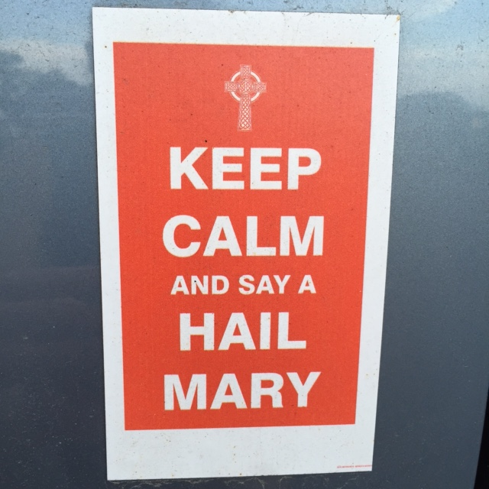

Slide 21
Sec. 200.3XX, Post-Award- Grantees
200.331, Requirements for pass-through entities – NEW
Includes audit responsibilities (formerly in A-133)
Pass-through entities responsibilities:
Provide subaward information
Provide indirect cost rate
Perform risk assessment for subrecipent monitoring
Verify compliance to audit requirements
Report in accordance to FFATA

Slide 22
Sec. 200.4XX, Cost principles
200.407, Prior Written Approval – 22 items of cost
200.413, Direct costs
Paragraph (c) - Administrative SW can be direct costs - NEW
200.414, Indirect (F&A) Costs
Must accept approved negotiated rates, except
Allowed by Federal statute or regulation
Approved by agency head or delegate, OMB notified of deviations
10% of MTDC de minimis IDC
First timers and new grantees only
Can be used indefinitely
One time four-year extension of current approved rate (final and pre-determined rates only)

Slide 23
Sec. 200.4XX, Cost principles
200.430, Compensation – personal services – New Language
Removed A-21 examples
Internal controls are KEY
200.430(i) – 9 standards for documenting personnel
E.g., supported by system of IC, budget estimates may be used
Substitute systems are allowed (430 (i) (5))
Blended and braided funds allowed, with Fed approval (430 (i) (7))
Use of institutional base salary for IHE

Slide 24
Sec. 200.4XX, Cost principles
200.431, Compensation – Fringe Benefits
Family friendly leave - NEW
200.432, Conferences
Costs are appropriate, necessary and minimized to the Federal award
Allow costs for finding local dependent care
200.446, Idle Facilities and Capacity
Necessary due to fluctuations in workload, e.g., shared services arrangements

Slide 25
Sec. 200.4XX, Cost principles
200.449, Interest
Section (b)(2), allow financing costs associated with patents and computer software – effective January 1, 2016
200.453, Materials and Supplies
Section (c) – can be charged as direct costs
Include computing devices (defined in 200.20)

Slide 26
Sec. 200.5XX, Audit Requirements
Revisions Focus Audit On Risk
Increases audit threshold.
Strengthens risk-based approach to determine Major Programs.
Provides for greater transparency of audit results.
Strengthens agency use of the single audit process.
Provides for public outreach to focus Compliance Supplement on requirements of highest risk.

Slide 27
Sec. 200.5XX, Audit Requirements Basic Structure of Single Audit Process Unchanged
Audit threshold (200.501).
Subrecipient vs. Contractor (200.501(f) & 200.330).
Biennial (200.504) & Program-specific (200.507) audits.
Non-Federal entity selects auditor (200.509).
Auditee prepares financial statements & SEFA(200.510).
Audit follow-up & corrective action(200.511 & 200.521).
9 month due date (set in law) (200.512(a)).
Reporting to Federal Audit Clearinghouse (200.512).
Major programs determined based on risk (200.518).
Compliance Supplement overall format (Appendix XI).

Slide 28
Highlights of Technical Corrections (9/2015)
200.110 - Effective date for procurement standards (200.317-200.326) deferred for two years after the Guidance goes into effect.
200.101 – Revised applicability table to be more consistent with Guidance.
200.308 – Revision of Budget and Program Plans; renumbered and made provisions for application of additional items of prior approval widely applicable (rather than limited to one item).
200.331 – Provides enhanced guidance on the content of awards by pass-through entities to subrecipients.
200.431 – Revised provisions for tuition remission as an allowable cost for undergraduate and graduates and to allow the provision of this benefit at other institutions according to institutional policy.

Slide 29
Highlights of New and Revised FAQs (9/2015)
.68-1 - Clarifies provision of $25K allowance for subawards when the subaward is renegotiated.
.110-6 - Revised to address application of the 2 year deferral of procurement requirements.
.112-2 - Guidance on the potential application of 200.112 (Conflict of Interest) to subawards for scientific collaboration.
.320-2 - Revised to provide examples of sole source procurements for research.
.323-1 - Clarifies that the cost or price analysis is not required for procurements up to the simplified acquisition threshold.
.414-8 - Addresses voluntary waiver or reduction of IDC.

Slide 30
Highlights of New and Revised FAQs (9/2015)
.425-4 – Clarifies that financial statement audits are an allowable cost for NFE exempted from Single Audit & Subpart F.
.425-5 – Clarifies that internal audit functions are allowable.
.449-1 – Clarifies implementation of the provision of interest costs for software development (Limited to assets acquired on or after the NFE fiscal years beginning on or after 1/1/16).
Appendix III-2 – Clarifies transition and application of the revised Utility Cost Adjustment.
Appendix III-3 – Requires the inclusion of salaries in excess of the HHS/NIH statutory limit in the MTDC base

Slide 31
Resources
The COFAR website is available at: https://cfo.gov/cofar/
Includes:
FAQs
Webcasts
Crosswalk to agency exceptions and additions

Slide 34
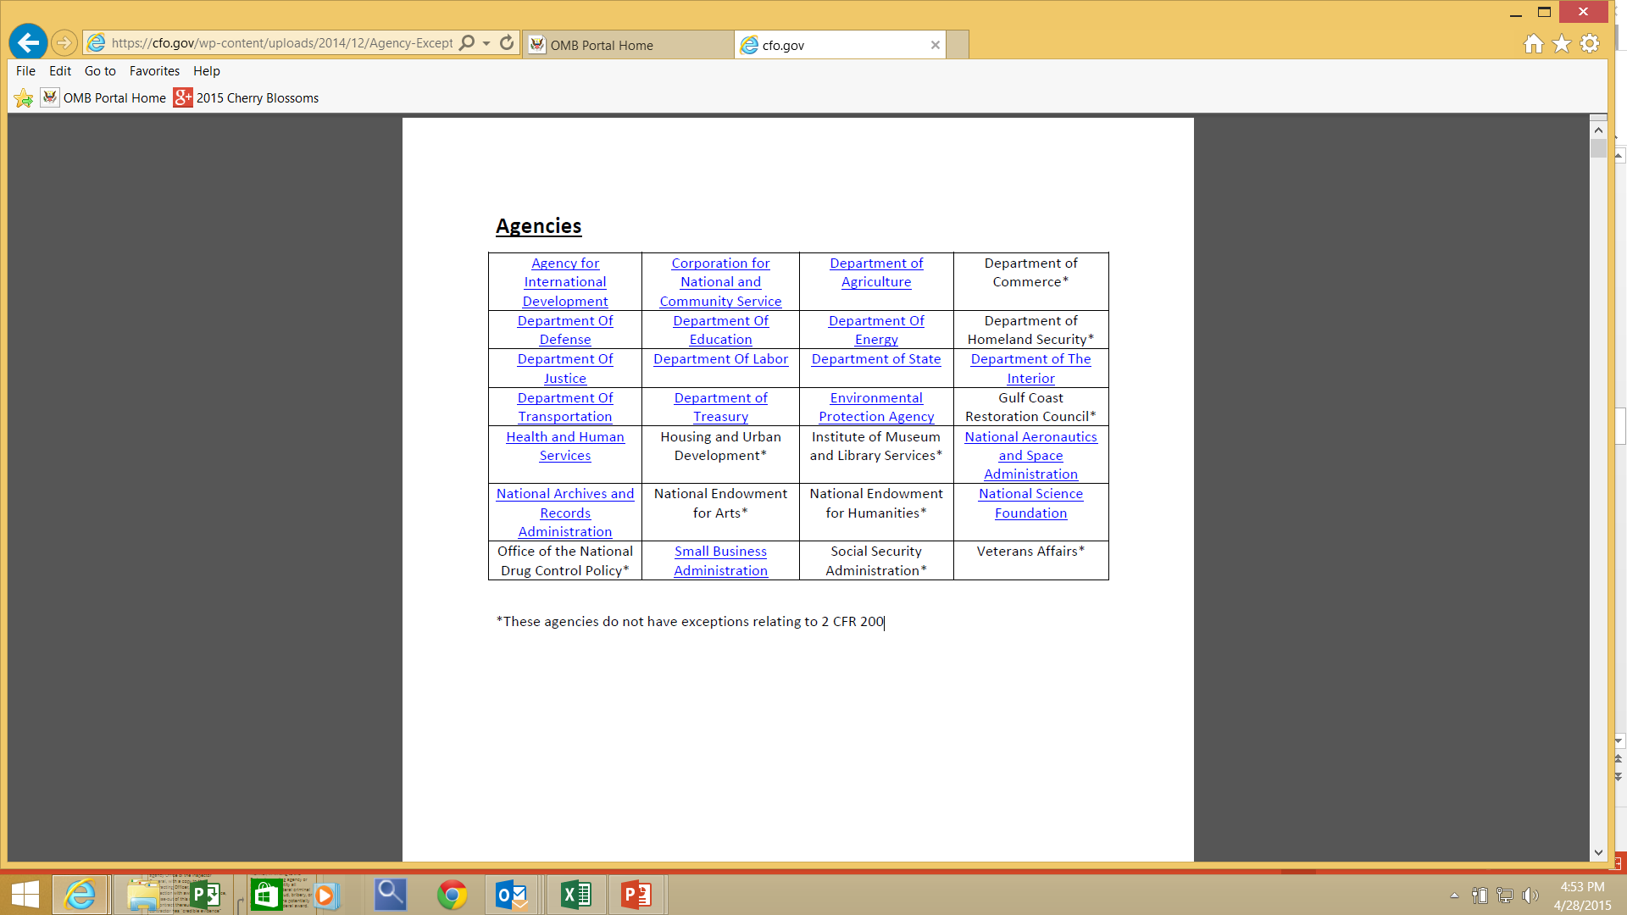

Slide 35
Department of Defense
§1103.100 Applicability of 2 CFR part 200 to requirements for recipients in DoD Components’ terms and
conditions
§1103.200 Exception for small awards
§1103.205 Timing of payments made using the reimbursement method
§1103.210 Management of federally owned property for which a recipient is accountable
§1103.215 Intangible property developed or produced under an award or subaward
§1103.220 Debarment and suspension requirements related to recipients’ procurements
§1103.225 Debt collection
Department of Education
§3474.5 How exceptions are made to 2 CFR part 200
§3474.10 Clarification regarding 2 CFR 200.207

Slide 37
Engage With COFAR
For More Information Visit:
CFO.gov/COFAR
Send Questions To:
COFAR@
omb.eop.gov
Thank you!

Slide 38
“I like the dreams of the future better than the history of the past…” T. Jefferson

